Slide 1
Prediction of Travel Ticket Cancellation
By: Rayyan Ghaus Rahmat

Slide 2
Objective
To avoid travel ticket cancellation

Slide 3
Outline
01
02
03
04
05
06
Business & Data Understanding
Data Preprocessing
Data
Analysis
Modelling
Conclusion
Business Recommendation

Slide 4
Business Understanding
Predicting travel ticket cancellations is crucial for various reasons:
Company Profitability: Anticipating cancellations can significantly impact company profit by optimizing income and enhancing the reputation of the travel agency. This involves strategies to increase income, expand services, and build a larger and better travel brand.
Operational Efficiency: By predicting cancellations, the travel agency can prioritize routes and transportation options that exhibit lower tendencies of ticket cancellations. This leads to improved operational efficiency as resources can be allocated more effectively.
Service Regulation: Understanding the timing of cancellations enables the implementation of effective service regulations. This knowledge can be leveraged to prevent ticket cancellations by creating and enforcing regulations that address common cancellation patterns.

Slide 5
About Dataset
The dataset contains various information about passengers who have registered for a trip through a travel booking website.
This dataset provides valuable insights into passenger travel patterns, booking behavior, and trip cancellations, which can be used for various analyses and predictions in the travel industry.
21
Features
13
Features
101017
Rows
101015
Rows
For more info: Kaggle

Slide 6
Data Understanding
Missing Values
No | Feature | Missing Values | Percentage(%)
1 | HashPassportNumber_p | 100155 | 99.15
2 | CancelTime | 85691 | 84.83
3 | UserID | 58474 | 57.89
4 | HashEmail | 57933 | 57.35
5 | VehicleClass | 38450 | 38.06
2
Duplicated Rows
2
Numerical Columns
11
Categorical Columns
For more info: Kaggle

Slide 7
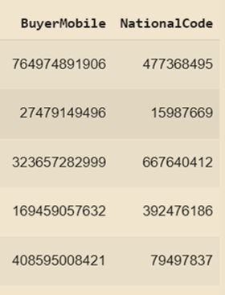
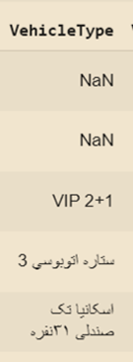
Data Understanding
Drop Effectless Columns
Drop NationalCode, BuyerMobile Because the data is provided in hashed version, it is difficult to process for machine learning and doesn’t effects cancellation.
Drop VehicleType because the data is not provided well. The data for VehicleType should be categorical so that insights can be extracted.
For more info: Kaggle

Slide 8
Data Analysis

Slide 9
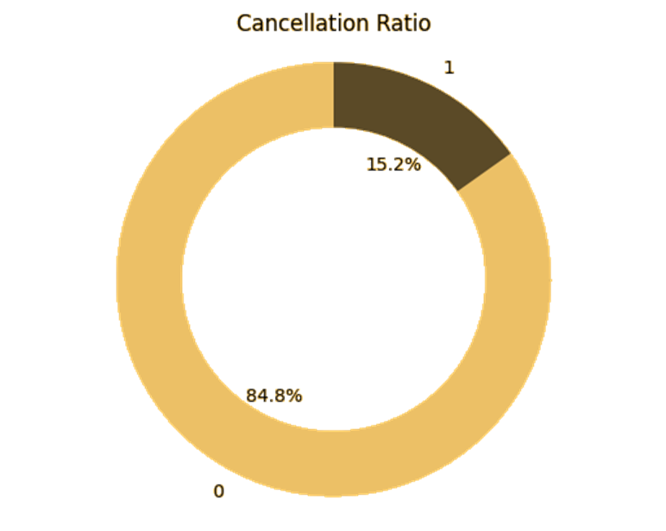
Cancellation
The cancellations ratio is quite skewed or imbalanced. Out of 101,015 rows, only 15.2% resulted in cancellations. Undersampling needs to be performed first to generate balanced data for using it in the machine learning process.

Slide 10
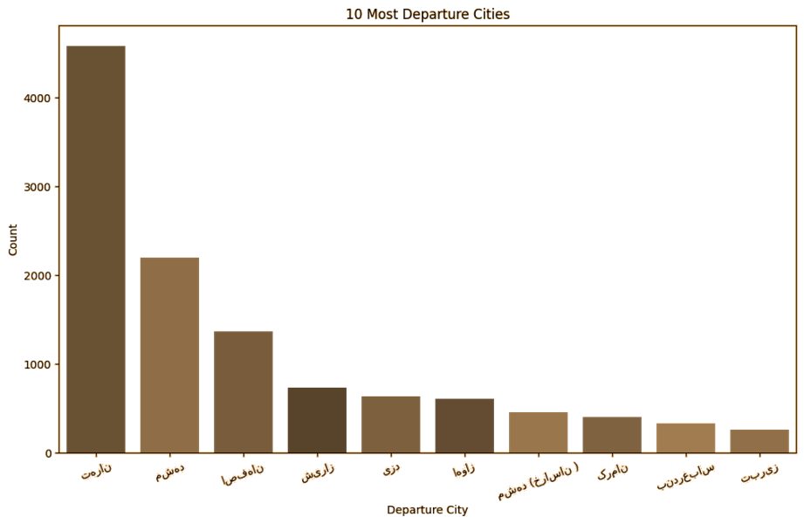
10 Most Departure Cities
No | City
1 | Tehran
2 | Mashhad
3 | Isfahan
4 | Shiraz
5 | Yazd
6 | Mashhad(Greater Khorasan)
7 | Ahvaz
8 | Kerman
9 | Qom
10 | Bandar Abbas

Slide 11
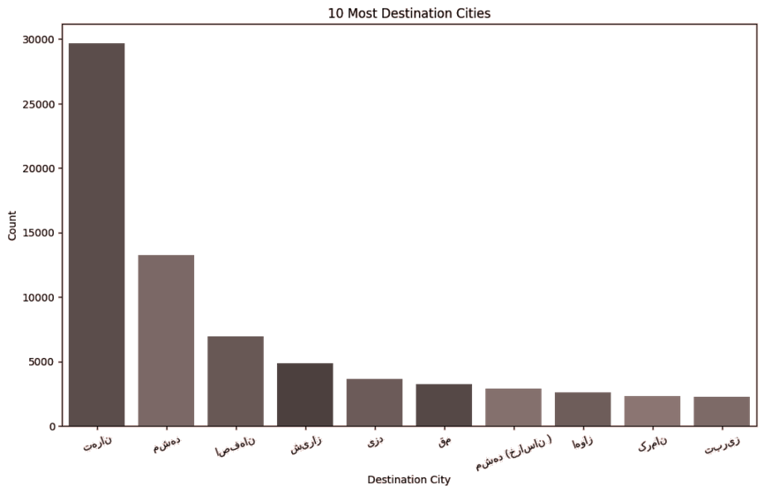
10 Most Destination Cities
No | City
1 | Tehran
2 | Mashhad
3 | Isfahan
4 | Shiraz
5 | Yazd
6 | Qom
7 | Mashhad(Greater Khorasan)
8 | Ahvaz
9 | Kerman
10 | Tabriz

Slide 12
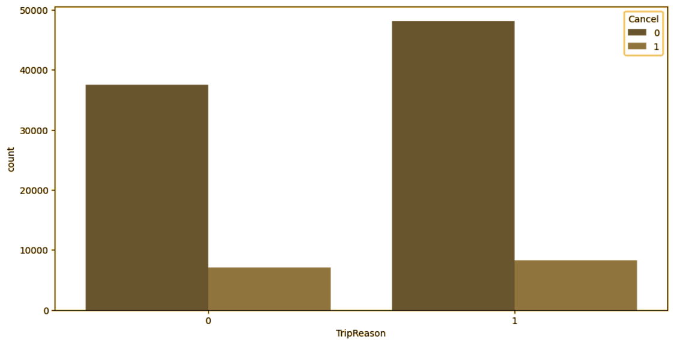
Cancellation and Trip Reason
1: Cancel
0: Non-Cancel

Slide 13
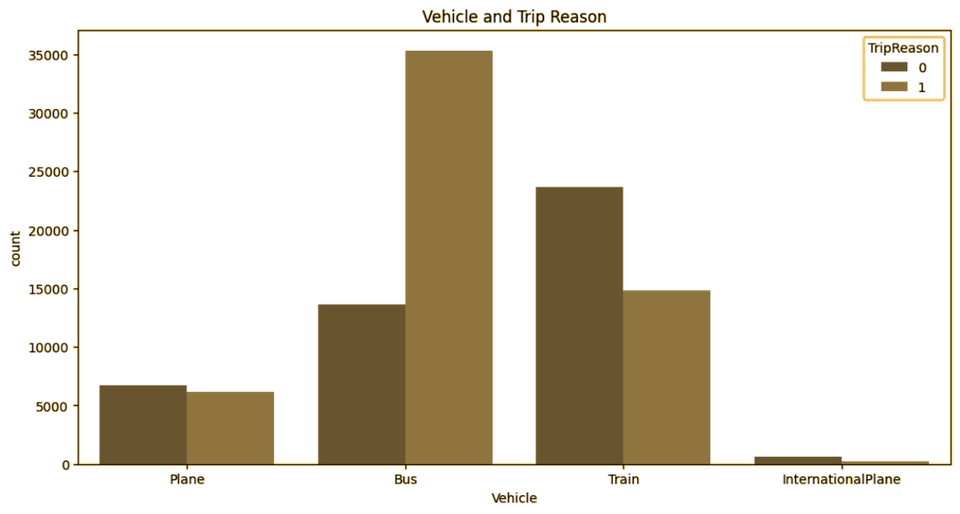
Vehicle and Trip Reason
1: Cancel
0: Non-Cancel

Slide 14
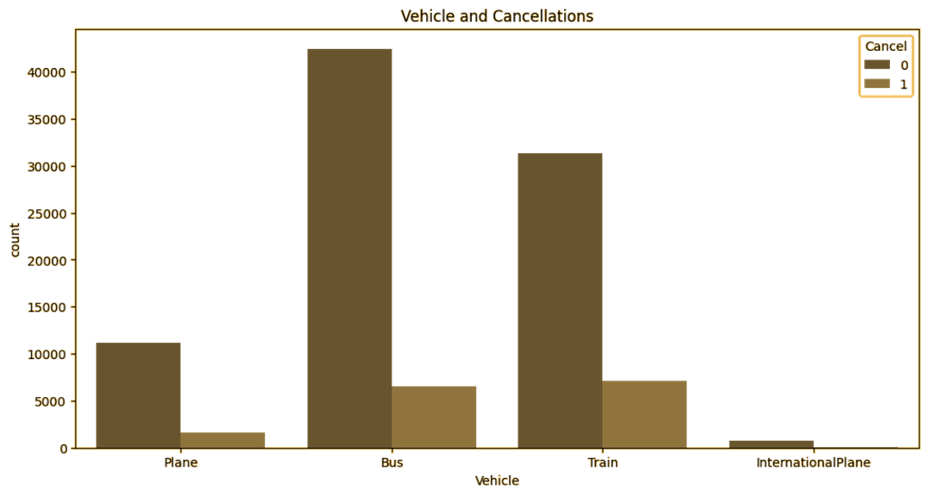
Vehicle and Cancellation
1: Cancel
0: Non-Cancel

Slide 15
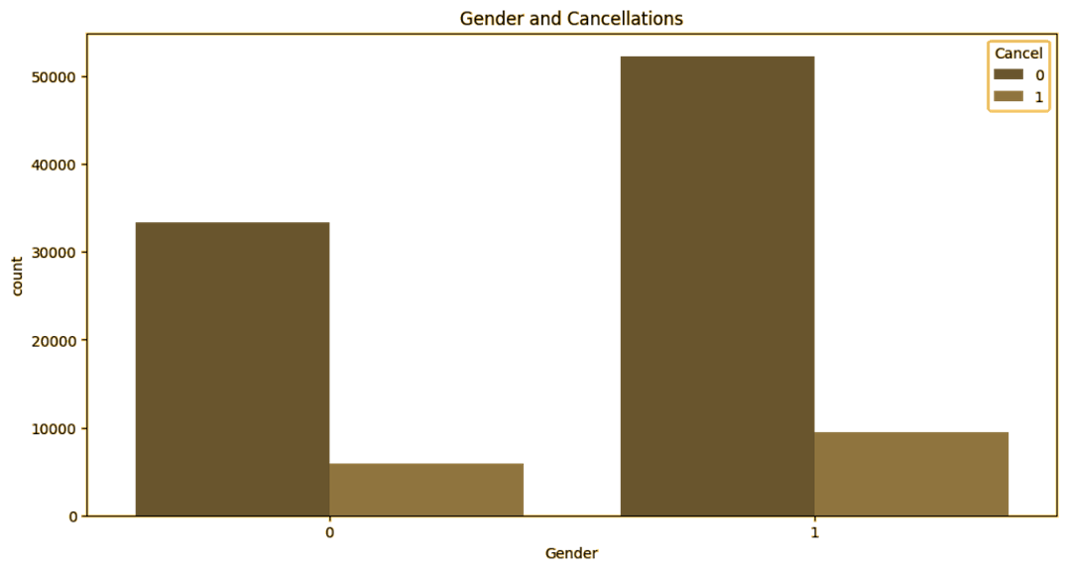
Gender and Cancellation
1: Male
0: Female
1: Cancel
0: Non-Cancel

Slide 16
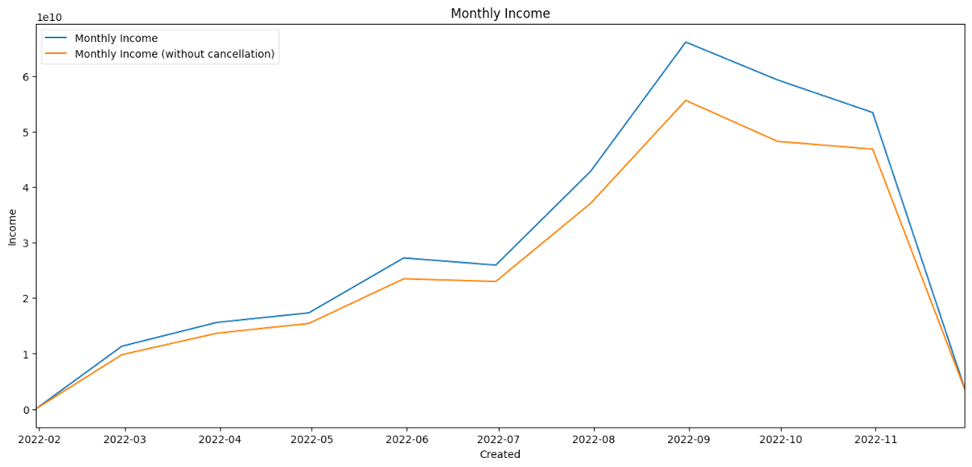
Monthly Income
There is a slight difference in income, between net income and gross income

Slide 17
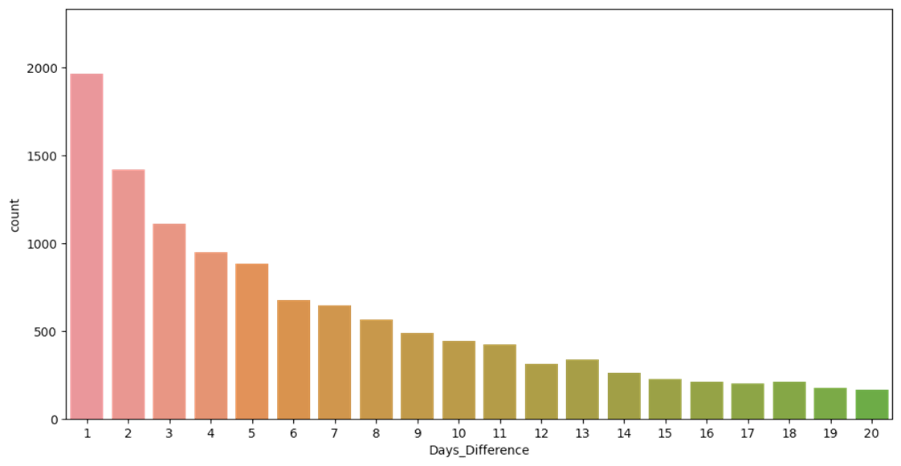
Cancellations From Days Difference
The ticket cancellation occurred within a short time frame between the booking time and departure time.

Slide 18
Modelling

Slide 19
Modelling
Split Data
1st Split: Pretrain 80% — Test 20%
2nd Split: Train 80% — Validation 20%
Metric
Baseline:
We use recall as a metric, because the data is imbalanced and we want to avoid false prediction of individuals who are predicted not to cancel but, in reality, they will cancel.
After preprocessing data:
We use accuracy as a metric, because we have handle the imbalanced data.

Slide 20
Modelling (Baseline)
Training Data Results
No. | Model | Accuracy | Precision | Recall | F1 Score
1 | XGBoost | 0.981439 | 0.988804 | 0.889247 | 0.936387
2 | KNN | 0.889377 | 0.758749 | 0.410391 | 0.532671
3 | Decision Tree | 0.973953 | 0.914722 | 0.915828 | 0.915275
4 | Random Forest | 0.980944 | 0.968145 | 0.905759 | 0.935913
Validation Data Results
No. | Model | Accuracy | Precision | Recall | F1 Score
1 | XGBoost | 0.981933 | 0.985961 | 0.893638 | 0.937532
2 | KNN | 0.892244 | 0.783163 | 0.400653 | 0.530110
3 | Decision Tree | 0.974855 | 0.919318 | 0.914519 | 0.916912
4 | Random Forest | 0.982379 | 0.973436 | 0.908646 | 0.939926

Slide 21
Modelling (After Preprocessing Data)
Training Data Results
No. | Model | Accuracy | Precision | Recall | F1 Score
1 | XGBoost | 0.958700 | 0.962366 | 0.955030 | 0.958684
2 | KNN | 0.629637 | 0.623873 | 0.659299 | 0.641097
3 | Decision Tree | 0.956979 | 0.957999 | 0.956555 | 0.957086
4 | Random Forest | 0.961377 | 0.966128 | 0.905759 | 0.961318
Validation Data Results
No. | Model | Accuracy | Precision | Recall | F1 Score
1 | XGBoost | 0.959009 | 0.962940 | 0.954027 | 0.958462
2 | KNN | 0.624809 | 0.616706 | 0.642394 | 0.629288
3 | Decision Tree | 0.953503 | 0.952542 | 0.953718 | 0.953130
4 | Random Forest | 0.963292 | 0.969346 | 0.956186 | 0.962721

Slide 22
Conclusion
The dataset consists of 101,017 rows and 21 columns. It is imbalanced and contains missing values, duplicated rows, and outliers. I performed label encoding, one-hot encoding, and changed the data type for the features. After preprocessing, the data has 25 columns and 32,686 rows. I split the dataset into 80% pretraining data and 20% test data, further dividing the pretraining data into training and validation sets.
I chose XGBoost, KNN, Decision Tree, and Random Forest as models to predict travel ticket cancellations. From the baseline model, I obtained results for training and validation that were not significantly different, indicating that the model is suitable for the data, except for the KNN model. The best result from the baseline model was the Decision Tree. After preprocessing the data, the results for training and validation were also not significantly different, indicating that the model is suitable for the data. The best result after preprocessing the data was Random Forest with higher accuracy than Decision Tree baseline model.
From this research, we can conclude that the performance of tree-based models is better than that of non-tree-based models. Tree-based models perform well even without preprocessing the data, suggesting that tree-based models are more robust with the data.

Slide 23
Business Recommendation
Tightening regulations on booking and cancellation processes aims to reduce cancellations.
Providing the option to reschedule for customers intending to cancel their travel tickets is essential.
We need to establish fixed departure schedules for each route to enhance company resource efficiency.
Offering travel options that allows customers to choose more cost-effective alternatives.
Promoting destinations with the highest demand helps decrease the likelihood of ticket cancellations.

Slide 24



Thank You
Contact.
rghausr@gmail.com

